Slide 1

Principle Of Marketing
Final Group Presentation
BBA iii
Syed Babar Ali (22FA-010-BA)
Hamza Qureshi (22SP-025-BA)
Syed Muhammad Yousuf (22SP-022-BA)

Slide 2

Introduction
The purpose of this presentation is to unveil the insights gained from our recent company visit and interview with Quantum Technologies marketing manager.
Through this presentation, we aim to shed light on the core values shaping Quantum Technologies identity, the specific goals set by the marketing team, and the tactics employed to achieve these objectives.

Slide 3
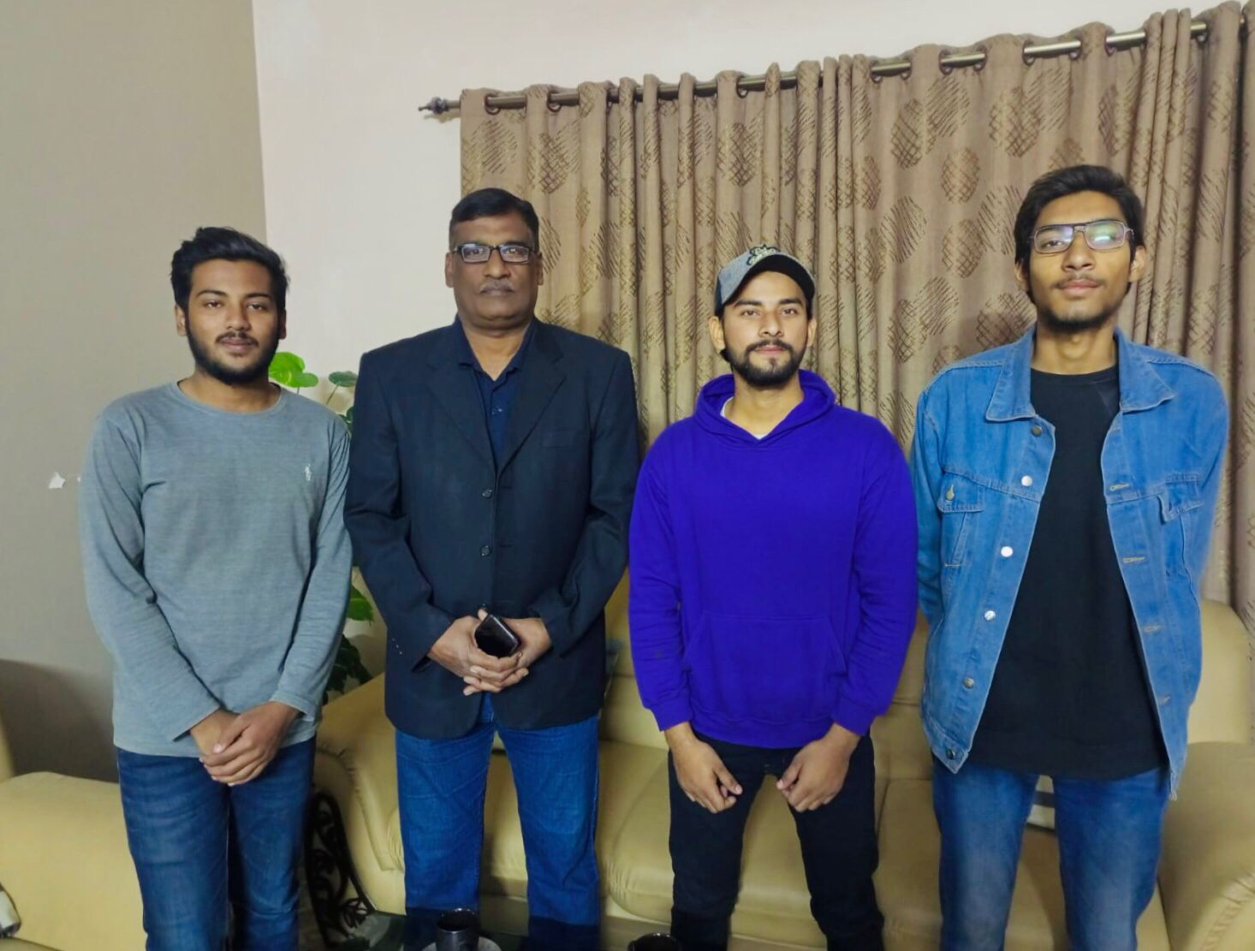
Visit to Quantum Technologies for meeting to Marketing Manager

Slide 4

Asked few Questions
We have asked few questions too the marketing manager of “Quantum Technologies” about their mission, visions and future goals

Slide 5
Company Introduction
Quantum Technologies started its operations in 2020.
Company goals: to achieve a one window hardware and software support solution provider Company in Pakistan, focusing on major brands such as HP, DELL, Kaspersky, Cisco, and Oracle.
Organized into three divisions:
- Sales & Marketing, headed by Basit.
- Technical Support, headed by Syed Basahrat Ali.
- Admin Finance & Logistics, headed by Bilal Ali.
Overall exchange & operation is led by Syed Rizwan Ali.

Slide 6
How They Promote their Company
Quantum Technologies employs a marketing division that organizes events, workshops, and engages in social media marketing to reach both corporate and private sectors with new technological hardware and software Solutions.
Recent Events that Quantum Technologies Takes part:
ITCN.
HP Corporate Event.
ABM Partnership event.

Slide 7
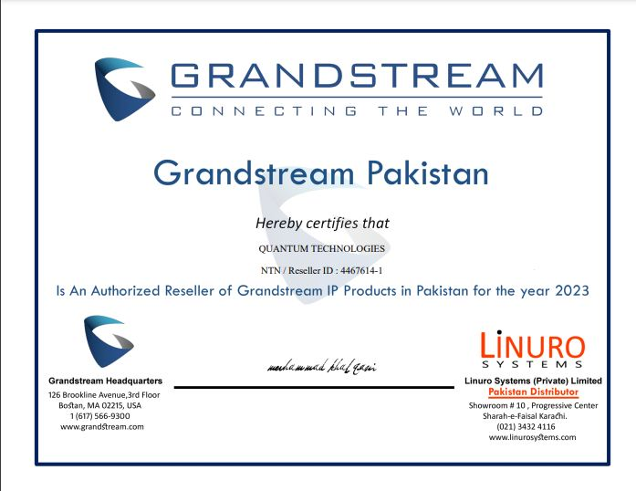
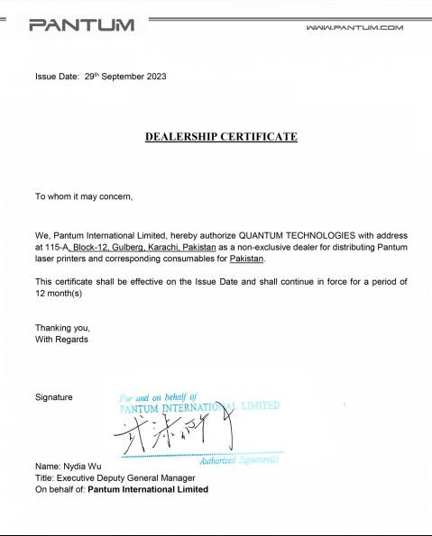
Authorized Resellers
Quantum Technologies have many Resellers that are authorized they also share their certificate with us:

Slide 8
Vision.
Mission.
Value Proposition.
Brand Traits.
Marketing Philosophy.

Slide 9
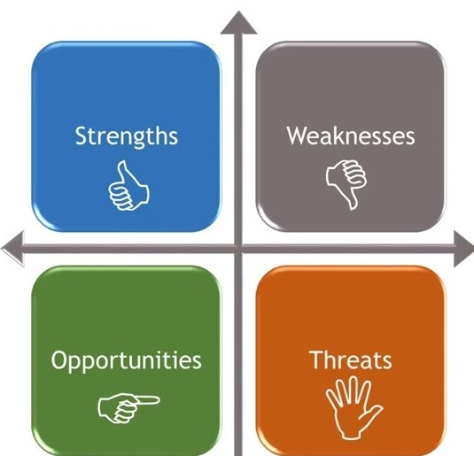
SWOT Analysis
Strengths:
Diverse product line and support infrastructure.
Weaknesses:
Limited market presence in certain segments.
Opportunities:
Expansion into emerging markets.
Threats:
Intense competition from existing market players.

Slide 10
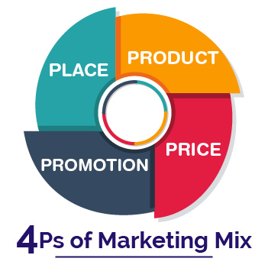
Marketing Mix of the Company:
Products/Services.
Pricing.
Place.
Promotion (Marketing Plan and Operations):

Slide 11
Conclusion:
Valuable Insights: Exploration provided deep insights into Quantum Technologies' future and strategic vision.
Dynamic Player: The company emerges as dynamic, committed to innovation and competitiveness.
Proactive Adaptation: Evident dedication to staying ahead and adapting to industry trends.
Positioned for Success: Quantum Technologies, with a proactive approach and robust strategic plan, is poised for sustained excellence and growth.

Slide 12
Thank you so much for your time and patience. Do you have any questions?

